Slide 1
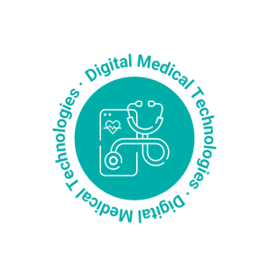



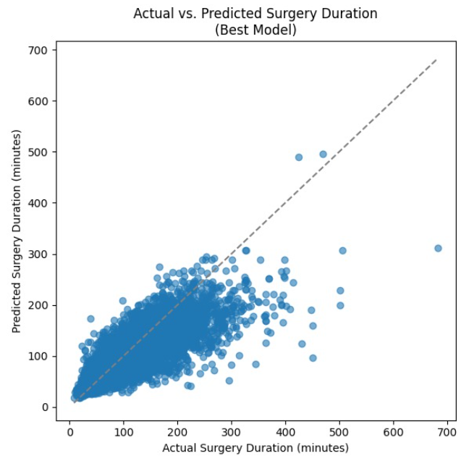
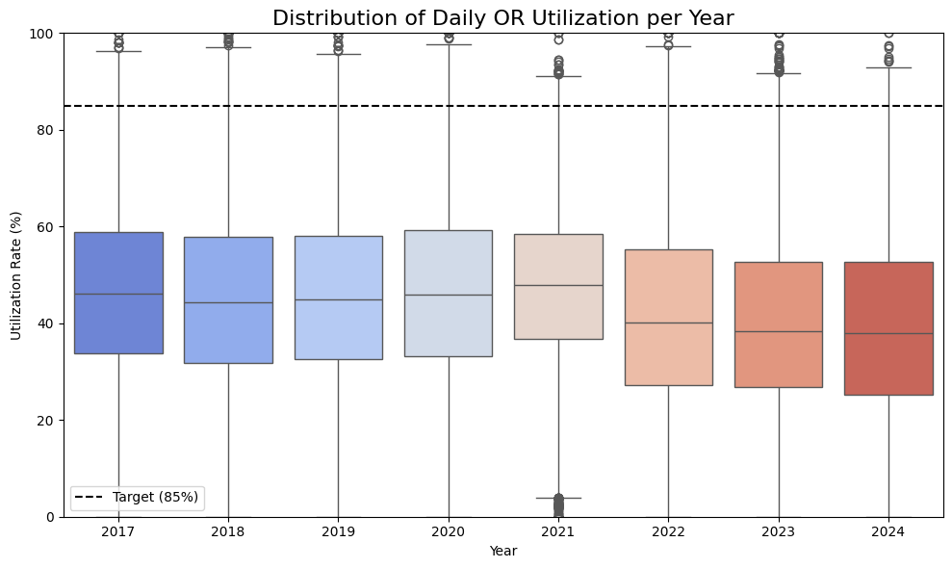
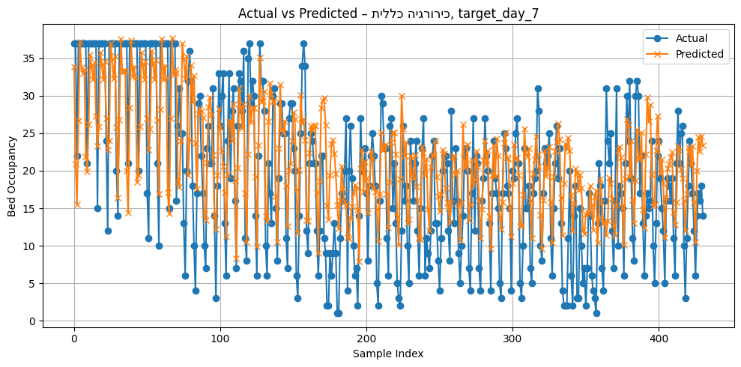
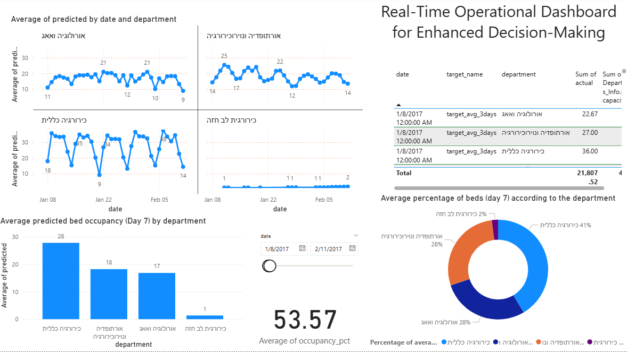
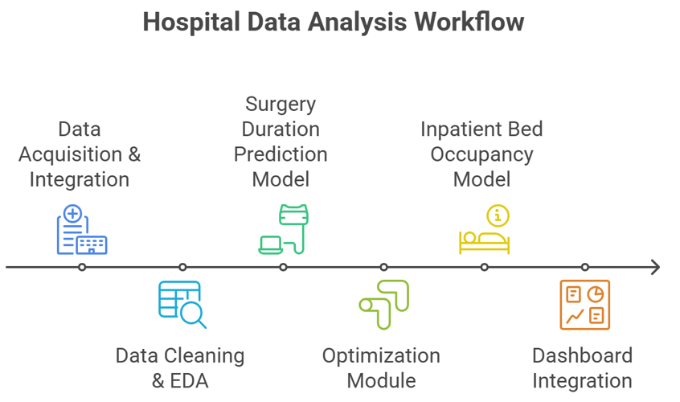

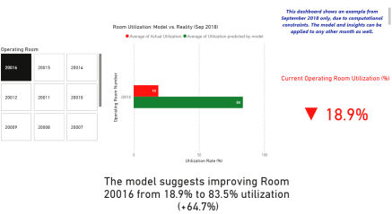
Department of Digital Medical Technologies
Research & Development – Final Projects
Healthcare Analytics, Medical Data Science | Anomaly Detection in Operating Room Performance Metrics and Development of a Bed Occupancy Prediction Model Supervisors: Prof. Aviv Gibali (HIT), Dr. Yariv Marmor (Braude College) & Dr. Royi Barnea (Assuta Ramat HaHayal) Students: Dvora Goncharok & Arbel Shifman
Introduction
Operating rooms (ORs) and inpatient beds are among the most critical—and limited—resources in hospitals. Inefficient scheduling leads to delays, cancellations, and suboptimal use of hospital infrastructure.
This project, conducted in collaboration with Assuta Ramat HaHayal, aimed to enhance operational efficiency using advanced analytics. We developed two machine learning models:
A surgery duration prediction model, using clinical and operational data.
An inpatient bed occupancy model, forecasting bed demand up to 7 days in advance.
An optimization module was also built to improve OR scheduling.
All components were integrated into an interactive Power BI dashboard for real-time decision support.
Methodology
We implemented a structured pipeline:
Data Acquisition & Cleaning – Multi-year surgical and hospitalization data was collected, cleaned, and unified.
Exploratory Data Analysis (EDA) – Key patterns, distributions, and outliers were identified.
Model Development:
Surgery durations were predicted using CatBoost, achieving MAE ≈ 19 minutes.
Bed occupancy was forecasted using BiLSTM, with R² ranging 0.4–0.6 for most departments.
Optimization Model – rolling horizon strategy aimed to enhance room utilization under real-world constraints.
Dashboard Integration – A real-time dashboard was developed to display model outputs and track key KPIs.
Conclusions
Optimized scheduling doubled OR utilization. across operating rooms
Built accurate models for predicting surgery duration (MAE ≈ 19 min):
and 7-day bed
occupancy (R² up to 0.61):
Generated daily utilization metrics per room, enabling granular performance analysis.
Integrated results into a dynamic Power BI dashboard for real-time decision support.
Outcomes align with project goals – enhancing planning, efficiency, and resource use.
Discussions
This project lays the foundation for a real-time hospital analytics system, supporting:
Smarter scheduling by combining machine learning models (e.g., for surgery duration prediction) with constraint-based optimization (CP), improving operating room efficiency.
Proactive planning for inpatient capacity, based on actual trends.
Integration into management workflows via dashboards. Further developments may include:
Real-time
feedback loops based on daily execution,
Enhanced ICU prediction modeling for critical surgeries,
Broader deployment across other Assuta branches.
Scan for demo & code:
Link to the Drive folder

